Slide 2




Open-Sourcing Your Oracle JDeveloper Extensions with Github
Jacob Danner
Senior Member of Technical Staff
Notes:
Welcome
Using Github to develop Open source JDeveloper Extensions

Slide 3
The following is intended to outline our general product direction. It is intended for information purposes only, and may not be incorporated into any contract.
It is not a commitment to deliver any material, code, or functionality, and should not be relied upon in making purchasing decisions. The development, release, and timing of any features or functionality described for Oracle’s products remains at the sole discretion of Oracle.
Notes:
Standard corporate legalese here
In development version of jdeveloper
Features get cut, whats in final release may be different than what you see here today
YMMV

Slide 4
The examples are not intended to be best practices or patterns. I’m not an expert in this stuff, but if I can figure it out, so can you.
Give it a try, and send me a pull request.
Notes:
None of us get better if we are scared of failure, fail and learn
Send me pull requests
Personal Disclaimer here
-These aren’t intended to demonstrate best practices
-None of us get better without practice
-send me a pull request

Slide 5
Program Agenda
Scratching the Itch
Basics of an Extension
Publish to Github
Review
Scratching the Itch
Basics of an Extension
Publish to Github
Review
Scratching the Itch
Basics of an Extension
Publish to Github
Review
Scratching the Itch
Basics of an Extension
Publish to Github
Review
Scratching the Itch
Basics of an Extension
Publish to Github
Review
Scratching the Itch
Basics of an Extension
Publish to Github
Review
Scratching the Itch
Basics of an Extension
Publish to Github
Review
Notes:
What we’ll talk about today
-How I found an itch to scratch and an interesting side project
-How to create an Extension in Jdeveloper
-How to let the world know you did something awesome using Github

Slide 6



Notes:
I spent some time tinkering with scripting languages like ruby, python, did some Scala
When I hit Groovy it just felt right
We moved to hudson and I started using it almost daily
Internal Update Center tooling and creation
reduced LOCs by almost 10x
much simpler than Plain Old Java, ie, if you do anything with XML
Now I look for ways to use it.

Slide 7

Notes:
But Alas, the tooling JDeveloper provides for Groovy is tailored to BC4J and ADF Development
NOT the kind of work I’m doing
I have to leave my normal environment environment for all the nice things an IDE provides
Eclipse, IntelliJ, netbeans.

Slide 8

“I have a great idea for Feature X. Who can I pay to implement it?”
“Short answer: preferably yourself.”
JDEVADF Team Wiki
Notes:
Team policy
As noted on some team wiki pages
Policy of scratching your own itch
Code speaks much louder than vaporware meetings

Slide 9
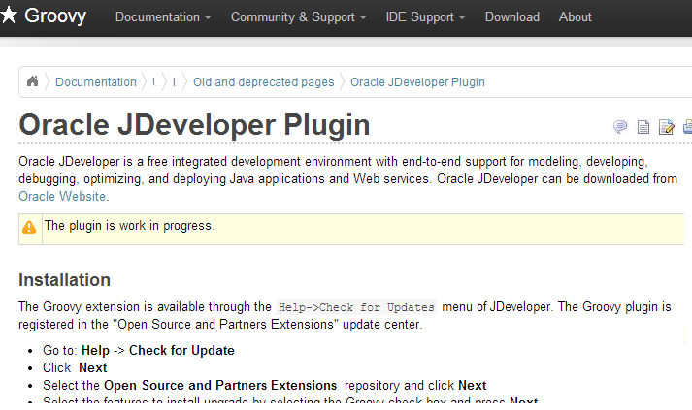
Notes:
So I started looking online and found someone else had a similar idea
Unfortunately, this extension was targeted for JDev 10.1.3 and I’m on 12.1.3
What was I to do?
Replicate the features listed to at least get parity with existing features

Slide 10
Base Features to Implement
What’s my MVP (Minimum Viable Product)?
Create a Groovy Script
  Wizards and Nodes
Enable a Groovy Library
  Extension.xml definition
Run the Groovy Script
  Starter API
Notes:
-What’s going into the MVP of this extension
-Whats the minimum set of things I need to get running so I’ll use this everyday
-Ability to create a new groovy script
--using Jdev’s extensive wizard / gallery / node apis
-Add a Library definition so other apps/modules can make use of groovy
-And lastly, run the scripts we are working on
-All of this is extremely simple if you know where to look in jdeveloper
-Feature creep sets in
groovy Console integration
External tool configuration
AST modeling in the JOT tree
Syntax highlighting
code completion
Other toolkit integration
Gradle
Grails

Slide 11
Prerequisites
It DOESN’T work on my machine
Install JDeveloper
Help → Check For Updates → Extension SDK
Groovy Installer Extension
  Downloads and installs Groovy 2.1.7
    Using Bundle.xml’s PostInstallerHook
  <install_dir>/jdeveloper/jdev/groovy
Notes:
.
-Quick note of prerequisites,
-For a better experience I’ve already gone through and installed everything via check for updates
-Created an extension that is really simple, there is a hook during bundle install that’s called that handles downloading and unzipping the groovy jar. If we have time I can cover that in more detail or we can talk after this session

Slide 12

Graphic Section Divider
Notes:
DEMO TIME
-File New->Extension Application
--Scroll to extension.xml
--Add Dependencies (javatools, java.core, gallery, jewt)
--Show manifest.mf changes
-Add New Wizard → Foo
--Modify Code
--Debug Extension
-File New → General → Foo → Dialog
--Go to extension.xml, show adding library
--component panel
--structure pane
-Go to Groovy Extension
--Show library defintion
--Tools → Manage Libraries
-Show runner extension.xml
--show process creation
--show how cmd is built up
-Execute Groovy Script

Slide 13

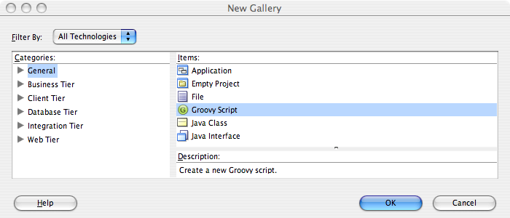
Create a Groovy Script
File → New → Gallery
Notes:
REVIEW
What’d we just do
Created a gallery item.

Slide 14
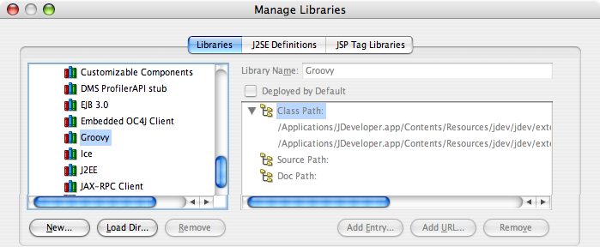
Enable a Groovy Library
Tools → Manage Libraries
Notes:
Created a Groovy Library

Slide 15
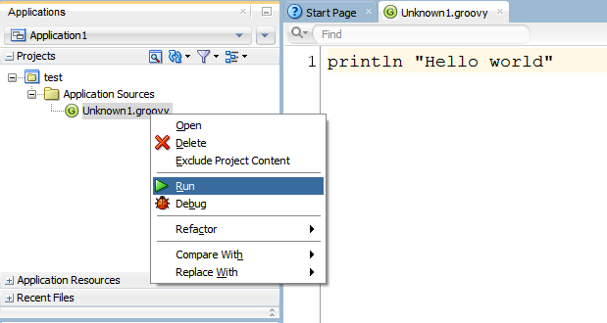
Run a Groovy Script
Select File → Run
Notes:
Running a script
Boom,
step 1, write the code, step 2 …, step 3 – profit

Slide 16

Github
Do they know about this!?!
Create a repository
Push to the repository
Host from the repository
Branches FTW!
Notes:
How many of you have used git and/or have a github account?
If you don’t have a github account, get one
Blog posting saying it’s the new tech resume
Github is a great service that provides a social experience for coding
They host code, no local backups required
Hosting these bits, ALL for FREE for OS projects

Slide 17
Create a repository
https://help.github.com/articles/create-a-repo
Basic Steps
  Git init
  Add a .gitignore
  Git add .
  Git status
  Git commit -m ”Your commit message”
git remote add origin https://github.com/<userid>/<projectname>.git
Notes:
These are the basic steps to making and using a git repository
based on the 3 of hands, I don’t need to spend much time covering this
git init, creates a .git folder in project root, all VCS metadata is stored here
practice to add .gitignore, exclude .class files, certain directories
add all the content you want, in most cases this is git add
Git status to see what state your repository is in
when you are ready, git commit to comit it to the branch
Push it to github
git push origin masterI

Slide 18
Create a repository – What Actually Happens
Basic Steps
  rm -rf .git
  repeat previous steps
We NEED to stop this
Notes:
-I see this happen quite frequently,
-A developer will write a whole bunch of code, make a bunch of mistakes
-get the application into working /pristine state
-remove all the version history
-submit a new application
-6 months of work shows up as a weekend project
-STOP IT

Slide 19
Quick Rant – Imposter Syndrome
“Everyone writes ugly code sometimes. Often you have to, before you can write something nice.”
-Jean-Paul Calderone http://as.ynchrono.us/
Google I/O 2009 - The Myth of the Genius Programmer
  http://www.youtube.com/watch?v=0SARbwvhupQ
Ruby Rogues – Imposter Syndrome
  http://rubyrogues.com/107-rr-impostor-syndrome-with-tim-chevalier/
Notes:
Leading into a quick rant on imposter syndrome
--That nervousness/anxiety where you feel like you don’t belong
--they are going to find out you are a fraud
Some good resources discussing this
--Myth of the genious programmer
--google code admins / remove commits
False sense of elitism
-I went through this several years ago
--found it limiting in my career
--actually hindered my growth because I was too scared to show failures
Get over it, admit fault
--It makes you a better team member
END RANT

Slide 20
Github
Branches FTW!
git checkout -b <branch>
git push origin <branch>
Notes:
Back to cool feature in git and github, FEATURE BRANCHES
--Allow you to take a copy of the repository
--Add some new features
--Test/Validate
--If it works submit
If it fails throw it away.

Slide 21
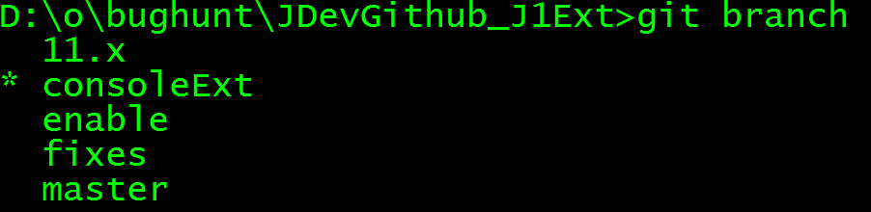
Notes:
Quick look at the command line method for working with git branches
Git branch to see what branch you are on
Lets see how github represents this in there webpage
CAVEAT → Don’t trust conference internet

Slide 22
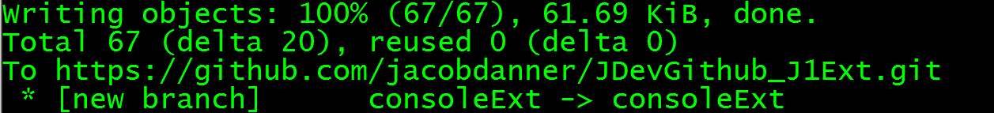
Notes:
DEMO GITHUB PUSH BRANCH
its as simple
git push origin <branchname>
Here is the output from the command line when you push
The github webpage for our project is shown here, I’m not sure if you can see it but the page for our repository tells us we just pushed our branch
We can select the branches we want

Slide 23
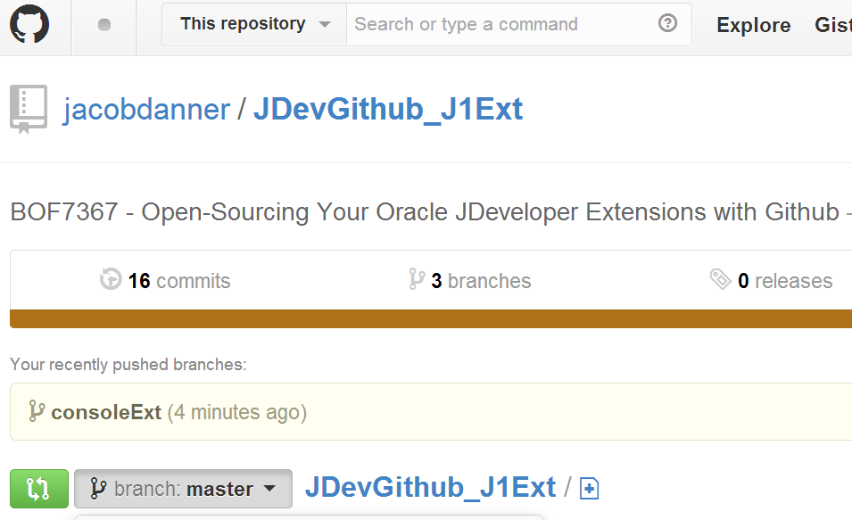
Notes:
The github webpage for our project is shown here, I’m not sure if you can see it but the page for our repository tells us we just pushed our branch
We can select the branches we want

Slide 24
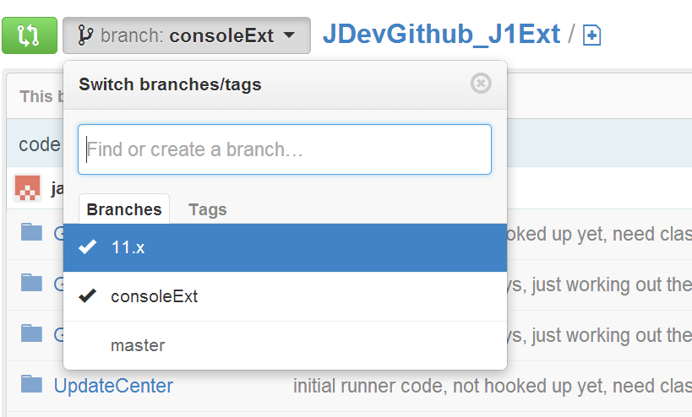
Notes:
We can select the branches we want

Slide 25
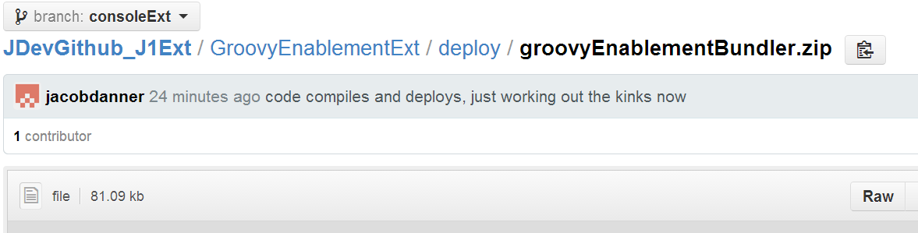
Notes:
YOU CAN THROW in BINARY content here and reference it based on distinct URL
This means you can let others use your code quickly and simply

Slide 26
Let Others Use Your Code
Update Centers
Github Raw URL links
  Hosting binary content
Alternative providers
  Jfrog’s bintray / artifactory
  How JDEVADF does things internally
Notes:
DEMO – Jdeveloper Update center
simple xml file,
host it with git also
When you need to make an update, its quick and simple
You can literally go to the web page and edit content like that

Slide 27
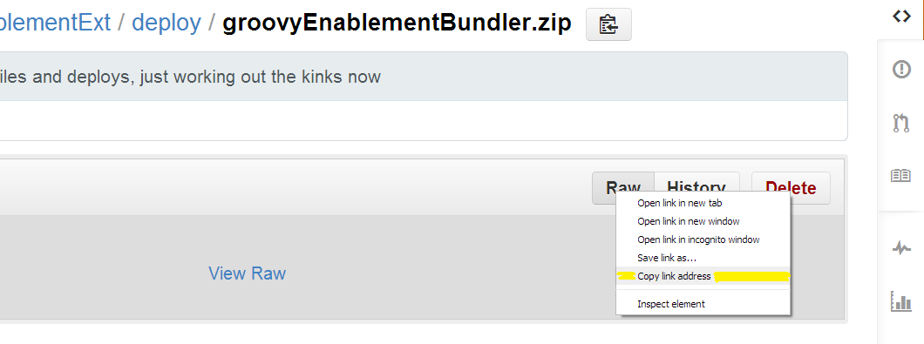
Notes:
host it with git also

Slide 28
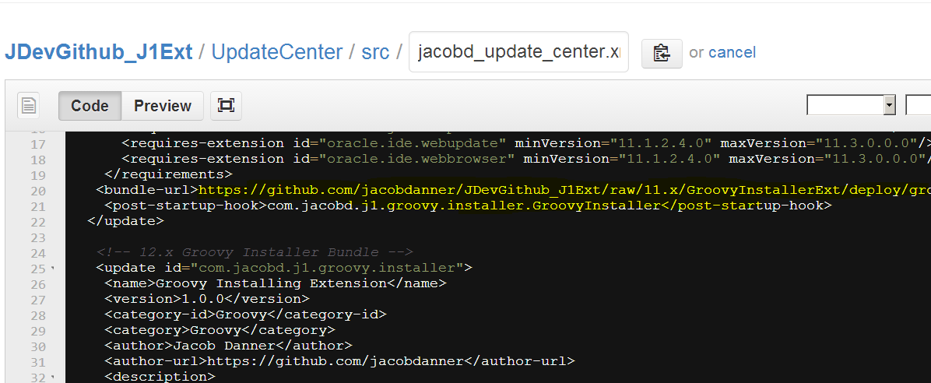
Notes:
When you need to make an update, its quick and simple
You can literally go to the web page and edit content like that

Slide 29
Github URL Schemes
Subject to Change
https://github.com/<user>/<project>/raw/<branch>/path/to/content
  AFAICT
jacobdanner/JDevGithub_J1Ext/raw/consoleExt/UpdateCenter/UpdateCenter.jpr
jacobdanner/JDevGithub_J1Ext/raw/master/UpdateCenter/UpdateCenter.jpr
Notes:
This is what I know to be the RAW binry URL content
NOTE: this is only something I’ve discovered, I have no control over it. Github could make a change and you’d be out of luck.

Slide 30
Github Pages
Ohh yeah, we’ll give you a website too
Notes:
Github even gives you the ability to create a website
Wat!?! What!?!

Slide 31
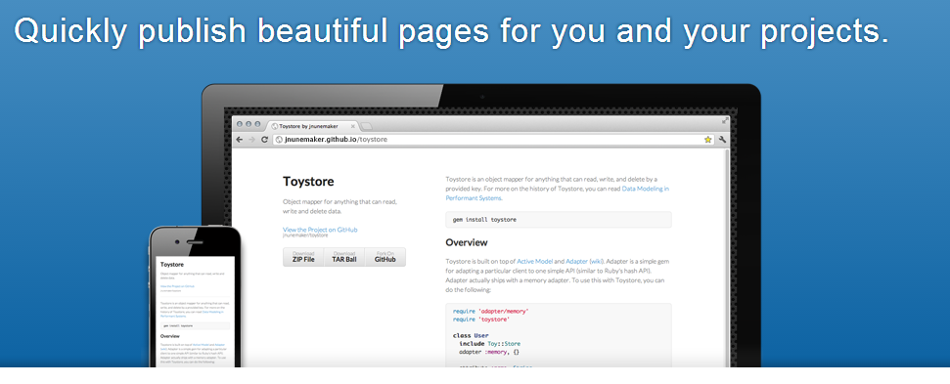
http://jacobdanner.github.io/jdev-copyright-plugin/
Notes:
Its a couple of clicks, and you are off and running

Slide 32
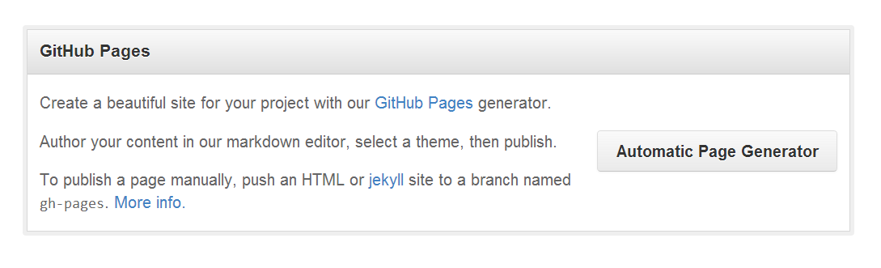
Notes:
go to project settings on the page, scroll down, select add automatic page generation

Slide 33



Useful for many other things
Applicable to Other IDEs
Eclipse
IntelliJ IDEA
Netbeans
Vim
Notes:
So of course we all use different tools for the job
Github can be used for hosting all sorts of things
eclipse
IntelliJ
Netbeans
EVEN VIM has plugins hosted
vim-plugins user

Slide 34
Review
Scratching the Itch
  Groovy Extension
Basics of an Extension
  Wizards, Libraries, Execution, Update Centers
Publish to Github
  Git basics
  Raw URLs
  Github Pages
Notes:
Quick review of what we accomplished in this talk
Walked through the basics of creating a Jdeveloper Extension
Talked/showed a bunch of github features that make all this development SOO much nicer

Slide 35
Thanks
Send Me a Pull Request https://github.com/jacobdanner/JDevGithub_J1Ext
Jacob.danner@gmail.com
Twitter: @ph477y
Github: jacobdanner
Notes:
My name Jacob Danner
Send me some pull requests

